Slide 1
NEXTHIKES IT SOLUTIONS
BUILDING A NEWS RESEARCH TOOL.
Naman Sharma

Slide 2
The Challenge in Equity News
Key Pain Points:
Information Overload: The sheer volume of data makes it impossible for analysts to process everything effectively.
Time-Intensive: Manually sifting through and analyzing news is a slow, time-consuming process.
Subjective Bias Risk: Analyst reports can inadvertently contain subjective biases.
Subtitle

Slide 3
Our AI-Driven Solution
Our Core Goal: To automate the collection and summarization of market news for equity research professionals.
Key Features:
Smart Content Retrieval: Automatically fetches the latest relevant news using external APIs (like NewsAPI / GNews).
Intelligent Summarization: Uses large language models (LLMs) via the Lang Chain framework to provide clear, concise article summaries.
Objective Insight: Automated sentiment detection (Positive / Negative / Neutral) provides fast, objective insights.

Slide 4
System Architecture & Workflow
Step 1: Data Acquisition: Latest news articles are fetched from a data source like NewsAPI.
Step 2: Core Processing: LangChain and a Large Language Model (LLM) are used to process the content.
This includes configuring the chain, setting up the API key (OpenAI/Groq), and using a prompt template for summarization.
Step 3: Output Generation: The model generates summarized insights for the articles.
Step 4: User Interface: A user-friendly Streamlit UI displays the results.

Slide 5
The User Experience
Key Dashboard Elements:
Input field for a specific
query (company name, sector, or event).
Adjustable parameters for the
maximum number of articles and the date range.
Interactive options to view both
per-article summaries and an overall summary tab.
Clear sentiment labels (
✓ Positive, × Negative, ◯ Neutral).
Option to
download reports as PDFs.

Slide 6
Future Vision & Enhancements
Future Development Areas:
Global Reach: Implementing multi-language support to analyze global news sources.
Advanced Prediction: Incorporating financial trend detection and generating predictive insights.
Deeper Analytics: Creating an advanced analytics dashboard with interactive visualizations.
Security & Personalization: Adding user authentication for a personalized experience and secure access.

Slide 7
Conclusion & Skills Demonstrated
Project Outcome: We have successfully delivered an AI-assisted equity research tool that automates news fetching, summarization, and sentiment analysis.
Core Technologies & Skills:
LLMs & Frameworks: LangChain, OpenAI/Groq.
Front-end & APIs: Streamlit, NewsAPI.
Development Practices: Environment setup, API key management with .env files, and project documentation (README, requirements.txt).

Slide 8
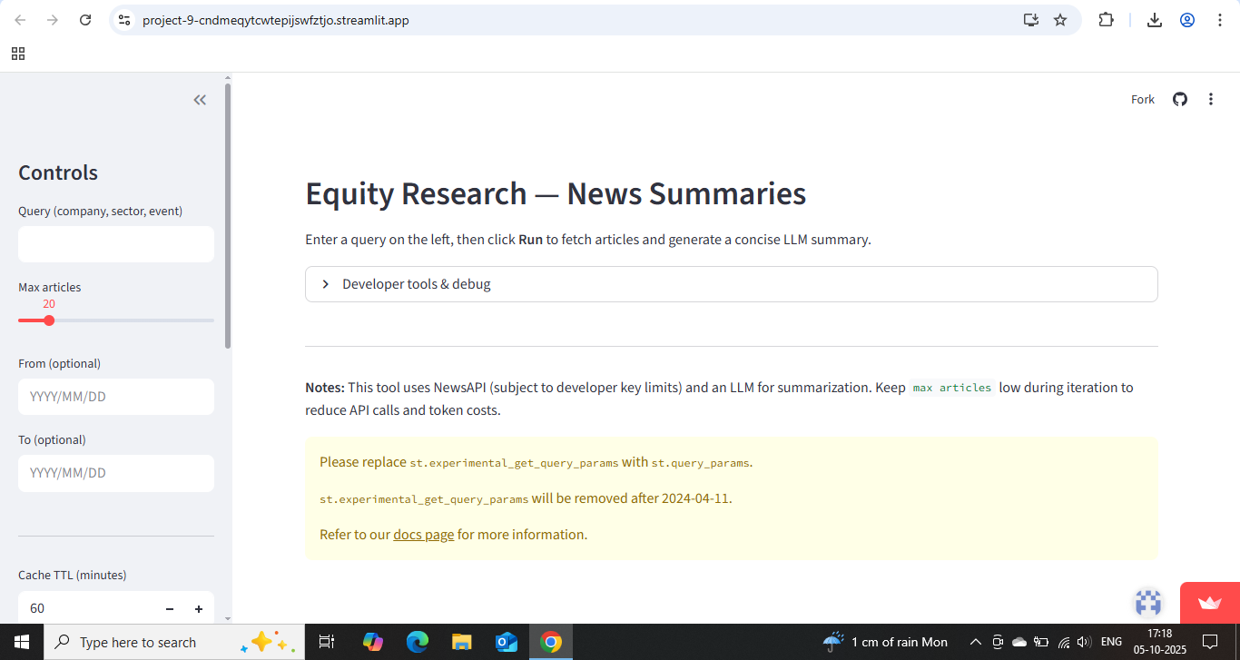
Dashboard Design.

Slide 9
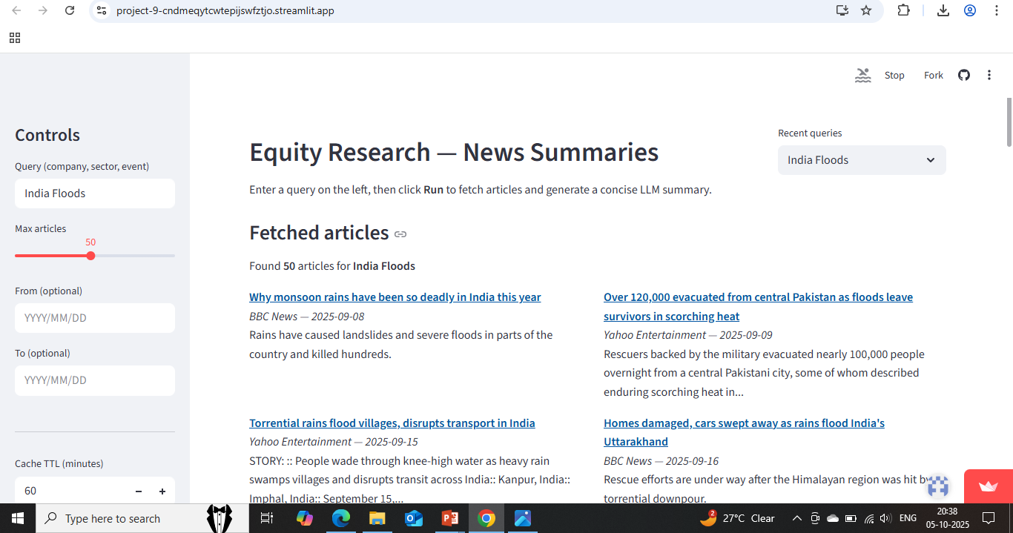
Testing Output.

Slide 10
THANK YOU.

